Slide 1
Presentation title with a maximum of approx. 80 characters
single line subtitle with a maximum of approx. 90 characters
Speaker
Date

Slide 2
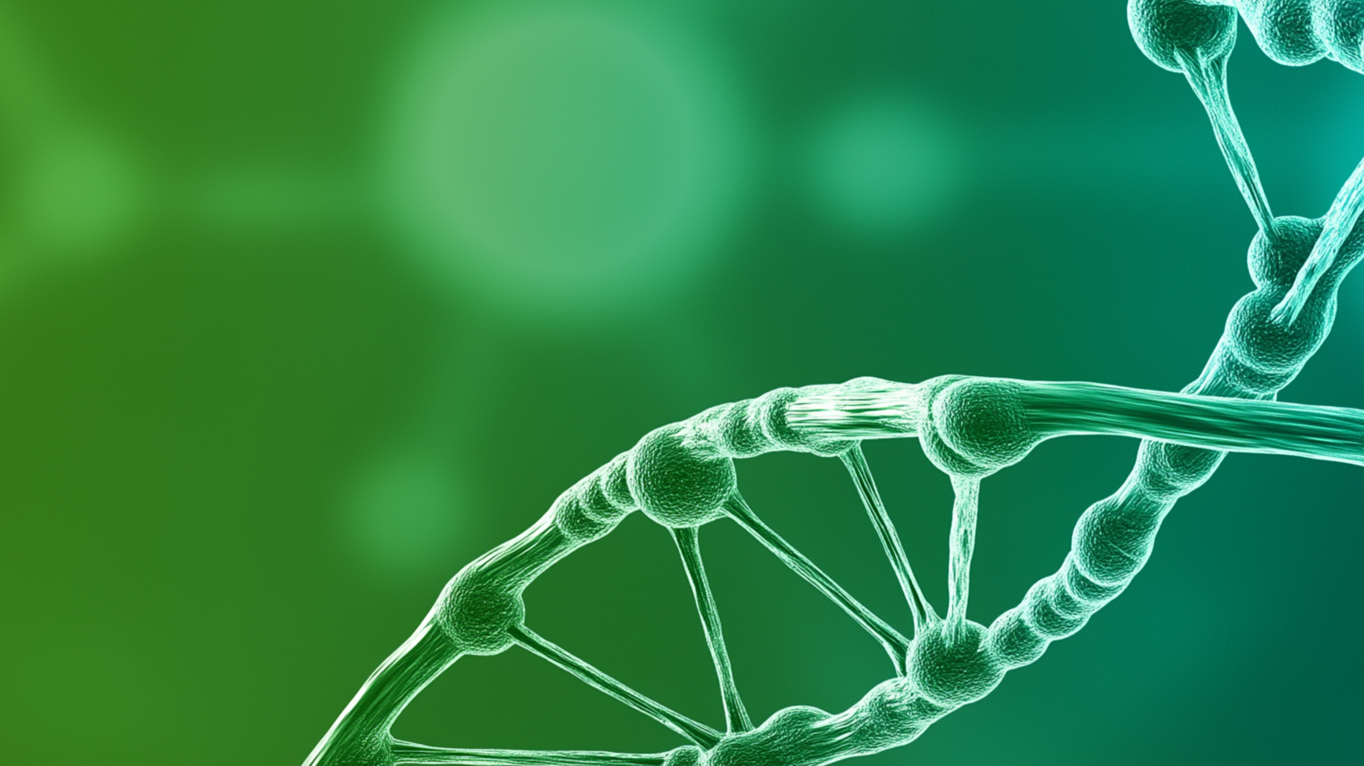
Presentation title with a maximum of approx. 80 characters
single line subtitle with a maximum of approx. 90 characters
Speaker
Date

Slide 3
Presentation title with a maximum of approx. 80 characters
single line subtitle with a maximum of approx. 90 characters
Speaker
Date

Slide 4

single line subtitle with a maximum of approx. 90 characters
Presentation title with a maximum
of approx. 80 characters
Speaker
Date

Slide 5
Chapter title with a maximum of approx. 80 characters
single line subtitle with a maximum of approx. 90 characters

Slide 6
Chapter title with a maximum of approx. 80 characters
01
Agenda topic with a maximum
of approx. 150 characters
single line subtitle with a maximum of approx. 90 characters

Slide 7
Chapter title with a maximum of approx.
120 characters in maximum two lines
single line subtitle with a maximum of approx. 100 characters
Text line one
Text line two
Text line three

Slide 8
Chapter title with a maximum of approx.
120 characters in maximum two lines
single line subtitle with a maximum of approx. 100 characters
Master text approx. 40 characters
Master text approx. 40 characters
Master text approx. 40 characters
Text line one
Text line two
Text line three
Text line one
Text line two
Text line three
Text line one
Text line two
Text line three

Slide 9
Speaker title with a maximum of approx.
120 characters in maximum two lines
single line subtitle with a maximum of approx. 100 characters
Speaker name and last name, job title, and location
with a maximum of approx. 140 characters in maximum two lines
2021 We choose to go to the moon in this decade and do the other things.
2016–2021 It suddenly struck me that that tiny pea, pretty and blue, was the Earth.
2008–2015 For those who have seen the Earth from space, and for the hundreds and perhaps thousands more who will, the experience most certainly changes your perspective.

Slide 10
Two Speakers title with a maximum of approx.
120 characters in maximum two lines
single line subtitle with a maximum of approx. 100 characters
Speaker name and last name, job title,
and location, max. approx. 75 characters
Speaker name and last name, job title,
and location, max. approx. 75 characters
2021 We choose to go to the moon.
2016–2021 It suddenly struck.
2008–2015 For those who have seen the Earth from space.
2021 We choose to go to the moon.
2016–2021 It suddenly struck.
2008–2015 For those who have seen the Earth from space.

Slide 11
Agenda title with a maximum of approx.
120 characters in maximum two lines
single line subtitle with a maximum of approx. 100 characters
01
Agenda topic in maximum
two lines
05
Agenda topic in maximum
two lines
02
Agenda topic
06
Agenda topic in maximum
two lines
03
Agenda topic in maximum
two lines
07
Agenda topic
04
Agenda topic in maximum
two lines
08
Agenda topic in maximum
two lines

Slide 12
Master title with a maximum of approx.
120 characters in maximum two lines
single line subtitle with a maximum of approx. 100 characters
For those who have seen the Earth from space, and for the hundreds and perhaps thousands more who will, the experience most certainly changes your perspective. The things that we share in our world are far more valuable than those which divide us.
It suddenly struck me that that tiny pea, pretty and blue, was the Earth. I put up my thumb and shut one eye, and my thumb blotted out the planet Earth. I didn’t feel like a giant. I felt very, very small.
We choose to go to the moon in this decade and do the other things, not because they are easy, but because they are hard, because that goal will serve to organize and measure the best of our energies and skills, because that challenge is one that we are willing to accept, one we are unwilling to postpone, and one which we intend to win.

Slide 13
Master title with a maximum of approx.
120 characters in maximum two lines
single line subtitle with a maximum of approx. 100 characters
Master subtitle with a maximum of approx.
180 characters in maximum two lines
For those who have seen the Earth from space, and for the hundreds and perhaps thousands more who will, the experience most certainly changes your perspective. The things that we share in our world are far more valuable than those which divide us.
It suddenly struck me that that tiny pea, pretty and blue, was the Earth. I put up my thumb and shut one eye, and my thumb blotted out the planet Earth. I didn’t feel like a giant. I felt very, very small.
We choose to go to the moon in this decade and do the other things, not because they are easy, but because they are hard, because that goal will serve to organize and measure the best of our energies and skills, because that challenge is one that we are willing to accept, one we are unwilling to postpone, and one which we intend to win.

Slide 14
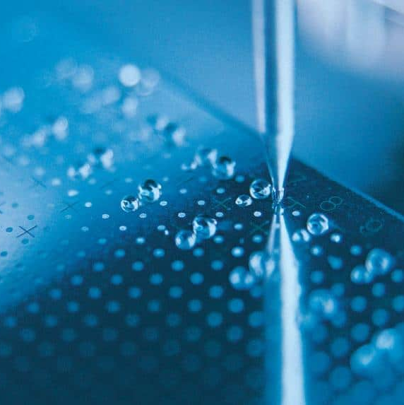
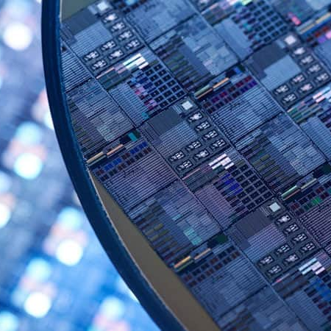
Master title with a maximum of approx.
120 characters in maximum two lines
single line subtitle with a maximum of approx. 100 characters
For those who have seen the Earth from space, and for the hundreds and perhaps thousands more who will, the experience most certainly changes your perspective.
It suddenly struck me that that tiny pea, pretty and blue, was the Earth. I put up my thumb and shut one eye, and my thumb blotted out the planet Earth.
There can be no thought of finishing for ‘aiming for the stars.’
Both figuratively and literally, it is a task to occupy the generations.

Slide 15
Master title with a maximum of approx.
120 characters in maximum two lines
single line subtitle with a maximum of approx. 100 characters
Master subtitle max. approx.
55 characters
For those who have seen the Earth from space, and for the hundreds and perhaps thousands more who will, the experience most certainly changes your perspective.
It suddenly struck me that that tiny pea, pretty and blue.
There can be no thought of finishing for ‘aiming for the stars.’
Both figuratively and literally, it is a task to occupy the generations.

Slide 16
Master title with a maximum of approx.
120 characters in maximum two lines
single line subtitle with a maximum of approx. 100 characters
For those who have seen the Earth from space, and for the hundreds and perhaps thousands more who will, the experience most certainly changes your perspective. The things that we share in our world are far more valuable than those which divide us.
It suddenly struck me that that tiny pea, pretty and blue, was the Earth. I put up my thumb and shut one eye, and my thumb blotted out the planet Earth. I didn’t feel like a giant. I felt very, very small.
Science has not yet mastered prophecy. We predict too much for the next year and yet far too little for the next 10.
We choose to go to the moon in this decade and do the other things, not because they are easy, but because they are hard, because that goal will serve to organize and measure the best of our energies and skills, because that challenge is one that we are willing to accept, one we are unwilling to postpone, and one which we intend to win.
There can be no thought of finishing for ‘aiming for the stars.’ Both figuratively and literally, it is a task to occupy the generations. And no matter how much progress one makes, there is always the thrill of just beginning.

Slide 17
Master title with a maximum of approx.
120 characters in maximum two lines
single line subtitle with a maximum of approx. 100 characters
Master subtitle with a maximum of approx.
85 characters in maximum two lines
Master subtitle with a maximum of approx.
85 characters in maximum two lines
For those who have seen the Earth from space, and for the hundreds and perhaps thousands more who will, the experience most certainly changes your perspective. The things that we share in our world are far more valuable than those which divide us.
It suddenly struck me that that tiny pea, pretty and blue, was the Earth. I put up my thumb and shut one eye, and my thumb blotted out the planet Earth. I didn’t feel like a giant. I felt very, very small.
We choose to go to the moon in this decade and do the other things, not because they are easy, but because they are hard, because that goal will serve to organize and measure the best of our energies and skills, because that challenge is one that we are willing to accept, one we are unwilling to postpone, and one which we intend to win.
There can be no thought of finishing for ‘aiming for the stars.’ Both figuratively and literally, it is a task to occupy the generations.

Slide 18

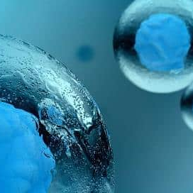


Master title with a maximum of approx.
120 characters in maximum two lines
single line subtitle with a maximum of approx. 100 characters
For those who have seen the Earth from space, and for the hundreds and perhaps thousands more who will, the experience most certainly changes your perspective.
It suddenly struck me that that tiny pea, pretty and blue, was the Earth. I put up my thumb and shut one eye, and my thumb blotted out the planet Earth.
Science has not yet mastered prophecy. We predict too much for the next year and yet far too little for the next 10.
We choose to go to the moon in this decade and do the other things, not because they are easy, but because they are hard, because that goal will serve to organize and measure the best of our energies and skills.

Slide 19
Master title with a maximum of approx.
120 characters in maximum two lines
single line subtitle with a maximum of approx. 100 characters
Master subtitle max. approx. 55 characters
Master subtitle max. approx. 55 characters
For those who have seen the Earth from space, and for the hundreds and perhaps thousands more who will, the experience most certainly changes your perspective.
It suddenly struck me that that tiny pea, pretty and blue, was the Earth.
Science has not yet mastered prophecy. We predict too much for the next year and yet far too little for the next 10.
We choose to go to the moon in this decade and do the other things, not because they are easy, but because they are hard.

Slide 20
Master title with a maximum of approx.
120 characters in maximum two lines
single line subtitle with a maximum of approx. 100 characters
For those who have seen the Earth from space, and for the hundreds and perhaps thousands more who will, the experience most certainly changes your perspective.
It suddenly struck me that that tiny pea, pretty and blue, was the Earth. I put up my thumb and shut one eye, and my thumb blotted out the planet Earth.
Science has not yet mastered prophecy. We predict too much for the next year and yet far too little for the next 10.
We choose to go to the moon in this decade and do the other things, not because they are easy, but because they are hard, because that goal will serve to organize and measure the best of our energies and skills.
There can be no thought of finishing for ‘aiming for the stars.’ Both figuratively and literally, it is a task to occupy the generations.
As I stand out here in the wonders of the unknown at Hadley, I sort of realize there’s a fundamental truth to our nature, Man must explore … and this is exploration at its greatest.

Slide 21
Master title with a maximum of approx.
120 characters in maximum two lines
Single line subtitle with a maximum of approx. 100 characters
Master subtitle max. approx.
55 characters
Master subtitle max. approx.
55 characters
Master subtitle max. approx.
55 characters
For those who have seen the Earth from space, and for the hundreds and perhaps thousands more who will, the experience most certainly changes your perspective.
It suddenly struck me that that tiny pea, pretty and blue, was the Earth.
Science has not yet mastered prophecy. We predict too much for the next year and yet far too little for the next 10.
We choose to go to the moon in this decade and do the other things, not because they are easy, but because they are hard.
There can be no thought of finishing for ‘aiming for the stars.’ Both figuratively and literally, it is a task to occupy the generations.
As I stand out here in the wonders of the unknown at Hadley, I sort of realize there’s a fundamental truth to our nature.

Slide 22
Master title with a maximum of approx.
120 characters in maximum two lines
single line subtitle with a maximum of approx. 100 characters

Slide 23
Master title with a maximum of approx.
120 characters in maximum two lines
single line subtitle with a maximum of approx. 100 characters
For those who have seen the Earth from space, the experience most certainly changes your perspective.
For those who have seen the Earth from space, and for the hundreds and perhaps thousands more who will, the experience most certainly changes your perspective.
It suddenly struck me that that tiny pea, pretty and blue, was the Earth.

Slide 24
Master title with a maximum of approx.
120 characters in maximum two lines
single line subtitle with a maximum of approx. 100 characters
For those who have seen the Earth from space, the experience most certainly changes your perspective.
For those who have seen the Earth from space, and for the hundreds and perhaps thousands more who will, the experience most certainly changes your perspective.
It suddenly struck me that that tiny pea, pretty and blue, was the Earth.

Slide 25
Master title with a maximum of approx.
120 characters in maximum two lines
single line subtitle with a maximum of approx. 100 characters

Slide 26
Master title with a maximum of approx.
120 characters in maximum two lines
single line subtitle with a maximum of approx. 100 characters
For those who have seen the Earth from space, the experience most certainly changes your perspective.
For those who have seen the Earth from space, and for the hundreds and perhaps thousands more who will, the experience most certainly changes your perspective.
It suddenly struck me that that tiny pea, pretty and blue, was the Earth.

Slide 27
Master title with a maximum of approx.
120 characters in maximum two lines
single line subtitle with a maximum of approx. 100 characters
For those who have seen the Earth from space, the experience most certainly changes your perspective.
The things that we share in our world are far more valuable.
It suddenly struck me that that tiny pea, pretty and blue, was the Earth.

Slide 28
Master title with a maximum of approx.
120 characters in maximum two lines
single line subtitle with a maximum of approx. 100 characters
For those who have seen the Earth from space, the experience most certainly changes your perspective.
The things that we share in our world are far more valuable.
It suddenly struck me that that tiny pea, pretty and blue, was the Earth.

Slide 29
Master title with a maximum of approx.
120 characters in maximum two lines
single line subtitle with a maximum of approx. 100 characters
For those who have seen the Earth from space, the experience most certainly changes your perspective.
The things that we share in our world are far more valuable.
It suddenly struck me that that tiny pea, pretty and blue, was the Earth.

Slide 30
Master title with a maximum of approx.
120 characters in maximum two lines
single line subtitle with a maximum of approx. 100 characters
For those who have seen the Earth from space, and for the hundreds and perhaps thousands more who will, the experience most certainly changes your perspective.
It suddenly struck me that that tiny pea, pretty and blue, was the Earth. I put up my thumb and shut one eye, and my thumb blotted out the planet Earth.
Headline in two lines | Headline | Headline | Headline in two lines | Headline | Headline | Headline
Topic 1 | 123 | 12314 | 1241244 | 1241241 | 12412442 | 12412
Topic 2 | 3463 | 2323, 264589 | 2324 | 3242434 | 234 | 2342342
Topic 3 | 457457 | 5555 | 444 | 4546456 | 344534 | 34523235
Total | 123 | 12314 | 1241244 | 1241241 | 12412442 | 12412

Slide 31
Master title with a maximum of approx.
120 characters in maximum two lines
single line subtitle with a maximum of approx. 100 characters

Slide 35
Primary, Secondary, and Accent Colors
Quick guide
Use grey tones to complement the blue range, e.g. for charts.
Use the accent color to highlight.
All Colors except Bruker Ocean, Red, and Green can be found in Theme Colors.
Bruker Ocean, Red, and Green can be found in Custom Colors.
Primary colors
Blue tones
Accent
color
Secondary colors
Grey tones
Bruker Ice
Red 4
Green 136
Blue 226
Hex #0488E2
Bruker Pacific
Red 4
Green 65
Blue 105
Hex #044169
Dolomite
Red 160
Green 160
Blue 160
Hex #A0A0A0
Obsidian
Red 49
Green 51
Blue 49
Hex #313331
Green
Red 127
Green 186
Blue 0
Hex #7FBA00
Bruker Ocean
Red 0
Green 98
Blue 164
Hex #0062A4
Bruker Glacier
Red 227
Green 235
Blue 243
Hex #E3EBF3
Granite
Red 115
Green 115
Blue 115
Hex #737373
Limestone
Red 220
Green 220
Blue 220
Hex #DCDCDC

Slide 36
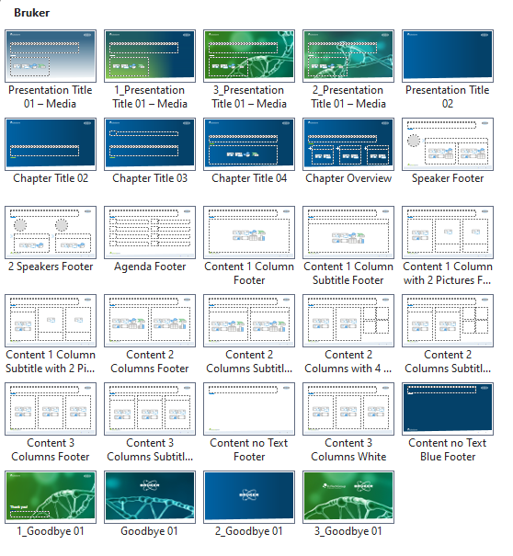
How to add a new Slide
Quick guide
There are numerous layouts for new slides available in this presentation master. To add a new slide, follow these steps:
In the top menu, go to „Home“ -> „New Slide“
Choose a slide layout and click on it to add a new slide

Slide 37
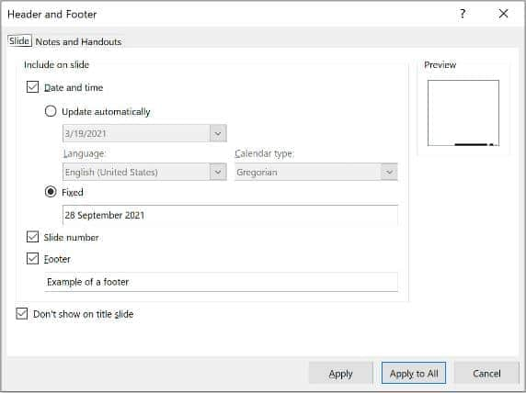
How to edit the Footer
Quick guide
The footer can be changed easily for every slide at once.
For that, follow these steps:
In the top menu, go to „Insert“ -> „Header & Footer“
Enter a new text for the footer
If you wish, activate „Date and time“ -> „Update automatically“
Click „Apply to All“
Please note:
Do not add a footer/date to neither presentation/chapter titles nor to goodbye slides.

